Slide 1
The Readiness Gap
Being Right Isn’t Enough

Slide 2
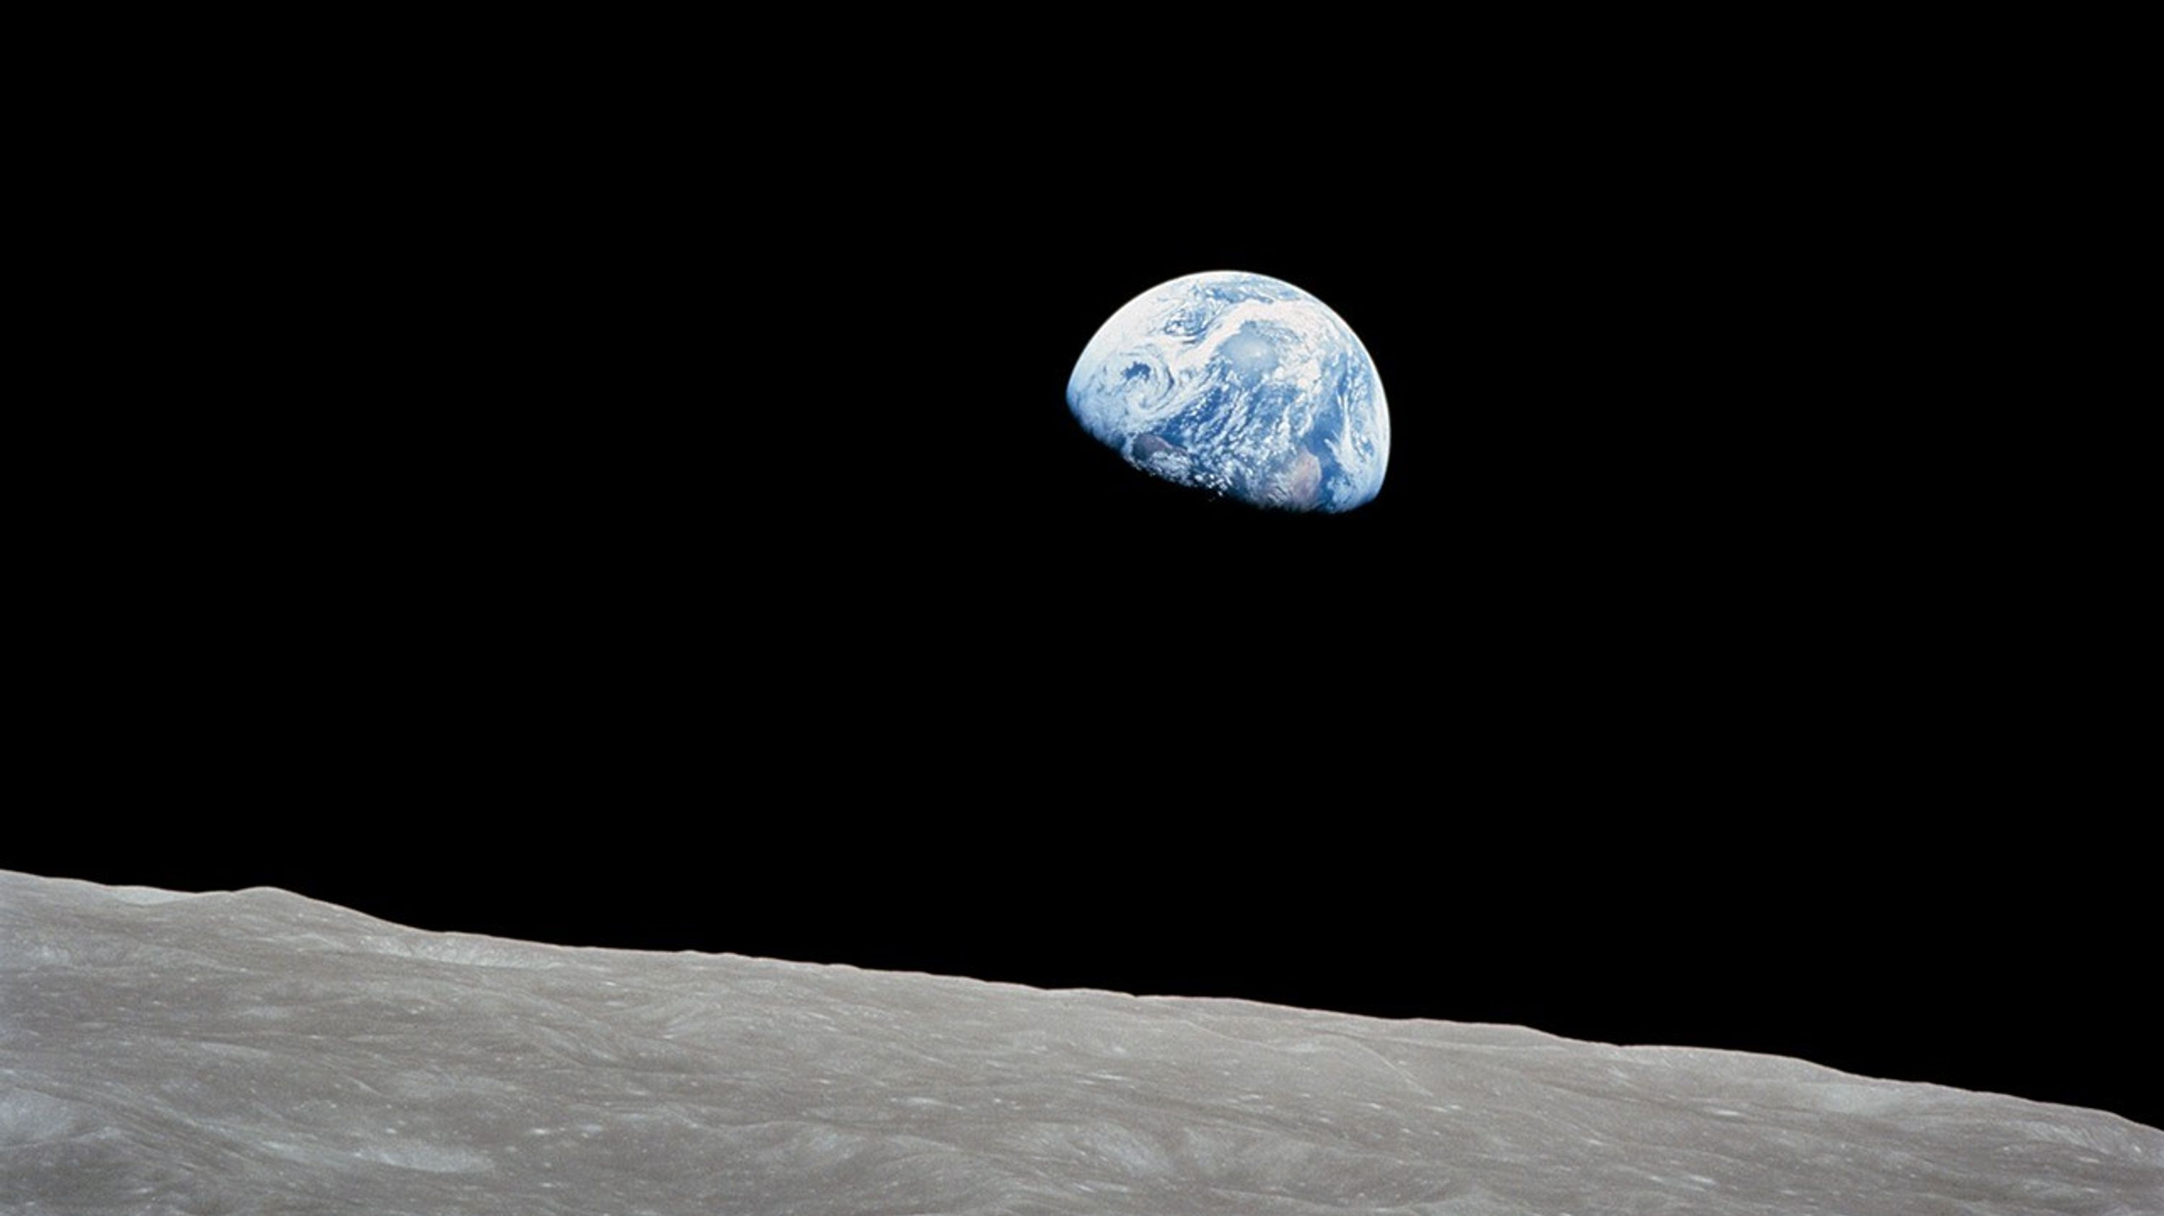

Slide 3
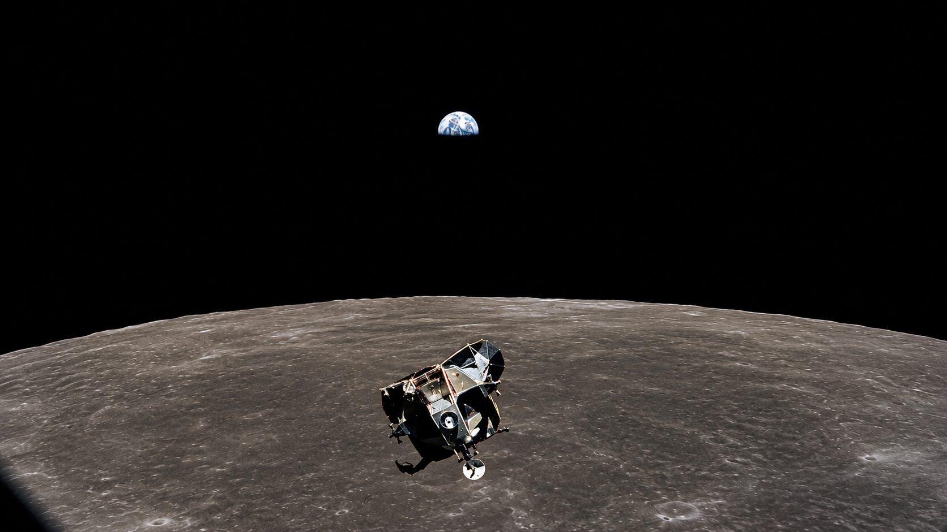

Slide 4
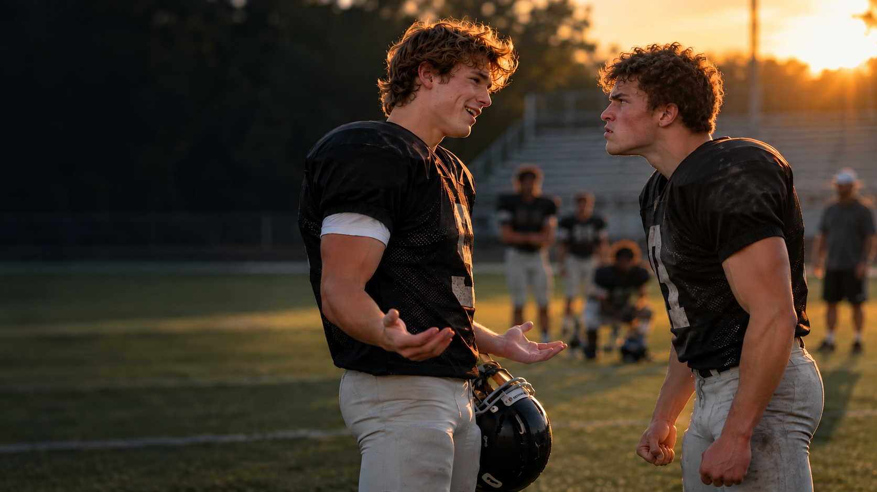

Slide 5
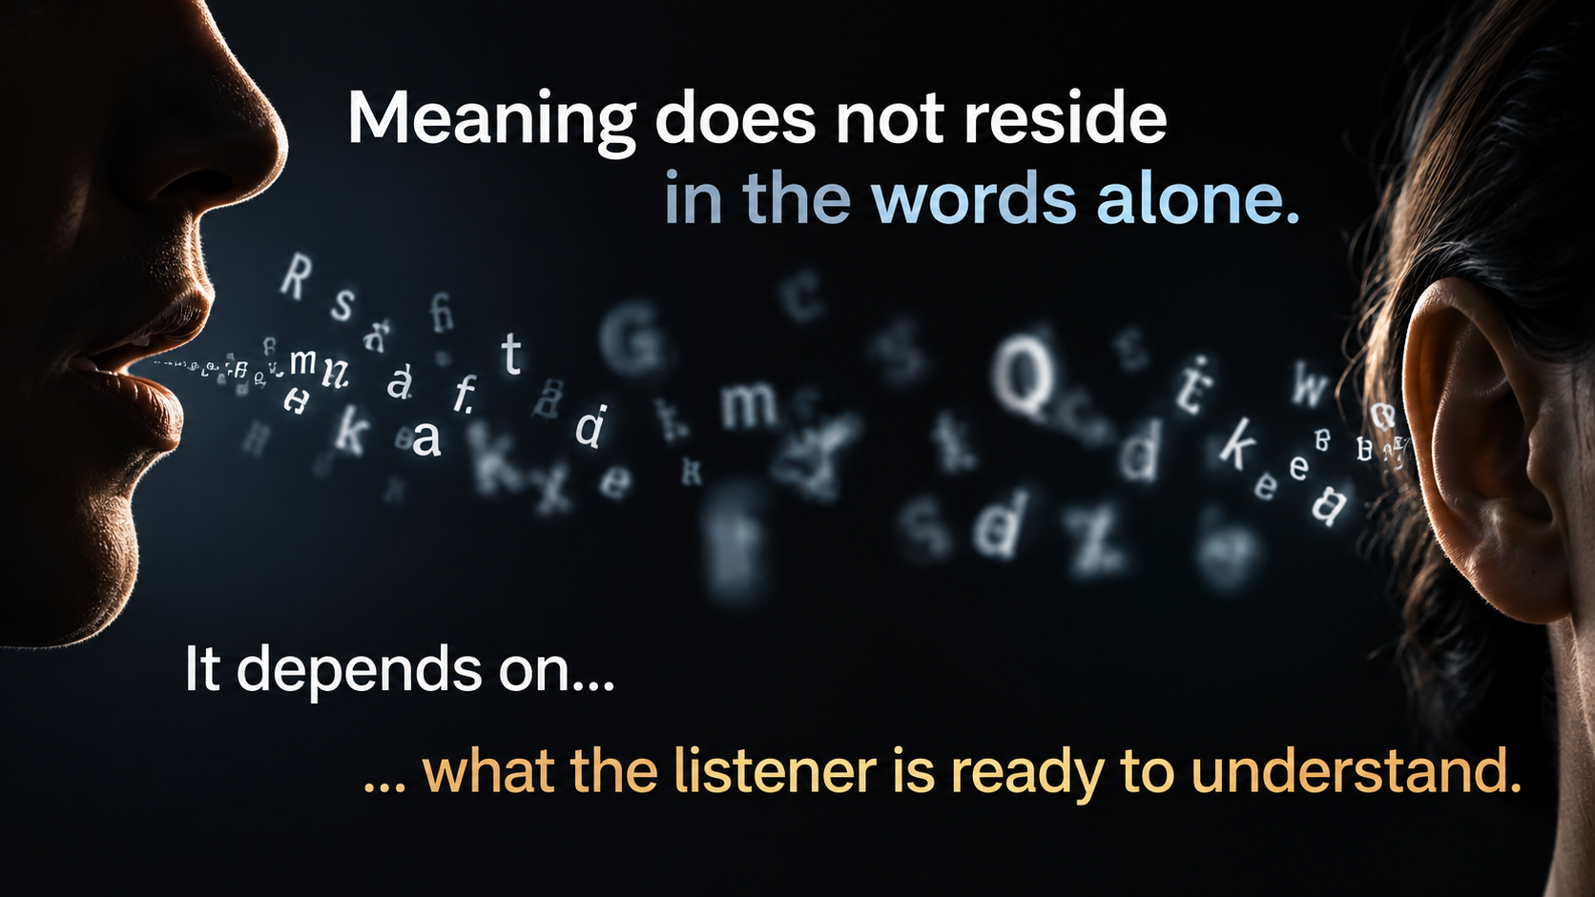

Slide 6
“Many scientific lectures are boring,
and some are downright dreadful.”
David R. Smith, EMBO Reports, 2025
“Scientific presentations are too often
boring and ineffective.”
Bruce Kirchoff, Nature, 2021

Slide 7
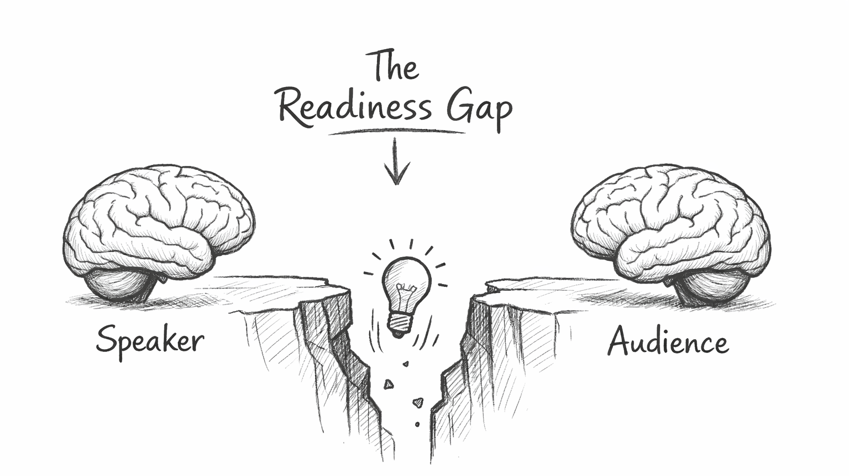

Slide 8
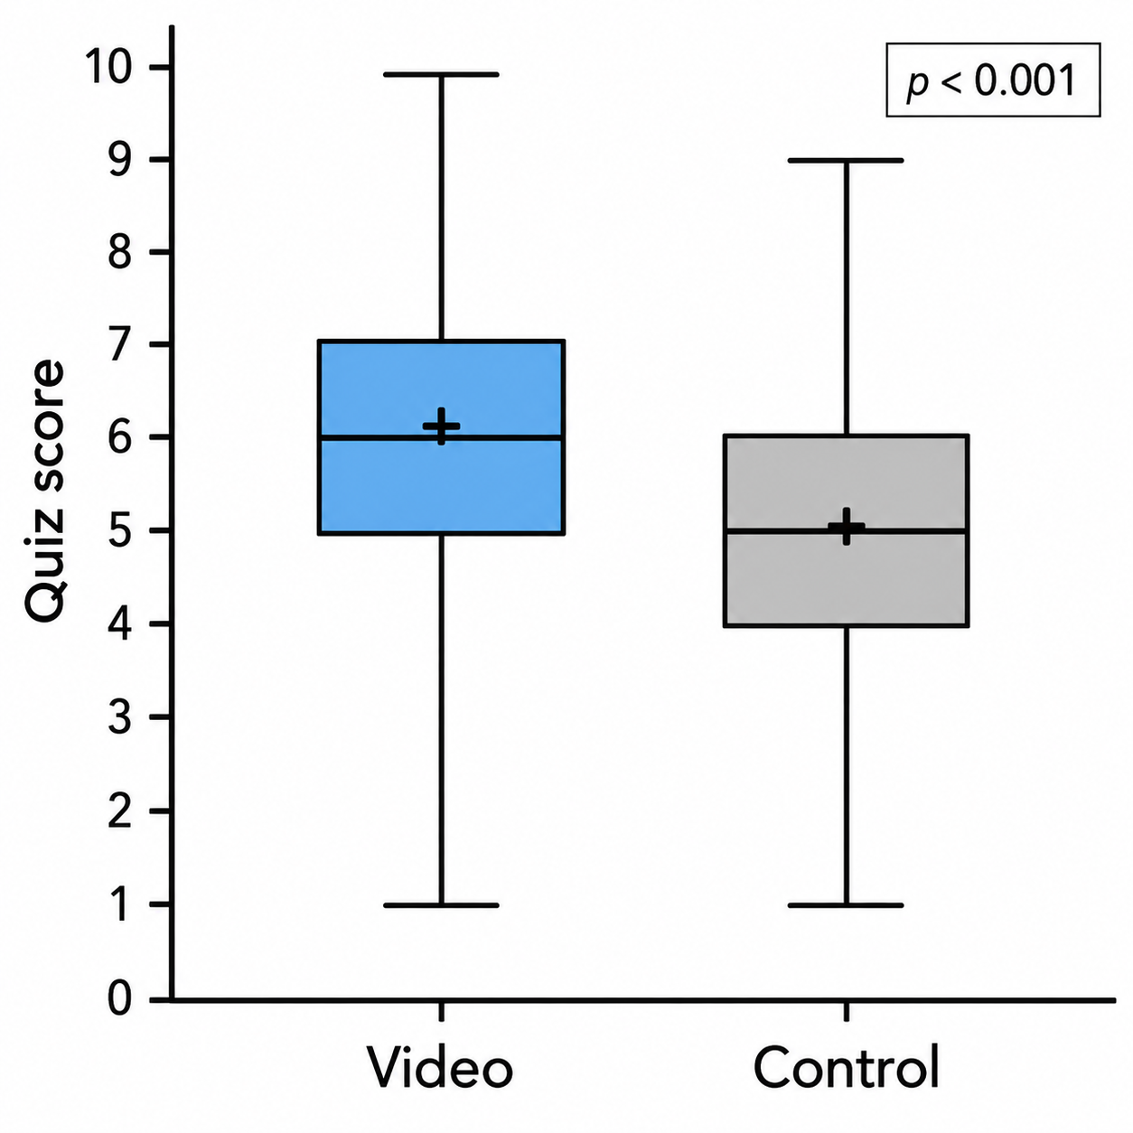
Derigs et al.

Slide 9
The Science Didn’t Change
The Audience’s Readiness Did…
Derigs et al.

Slide 10
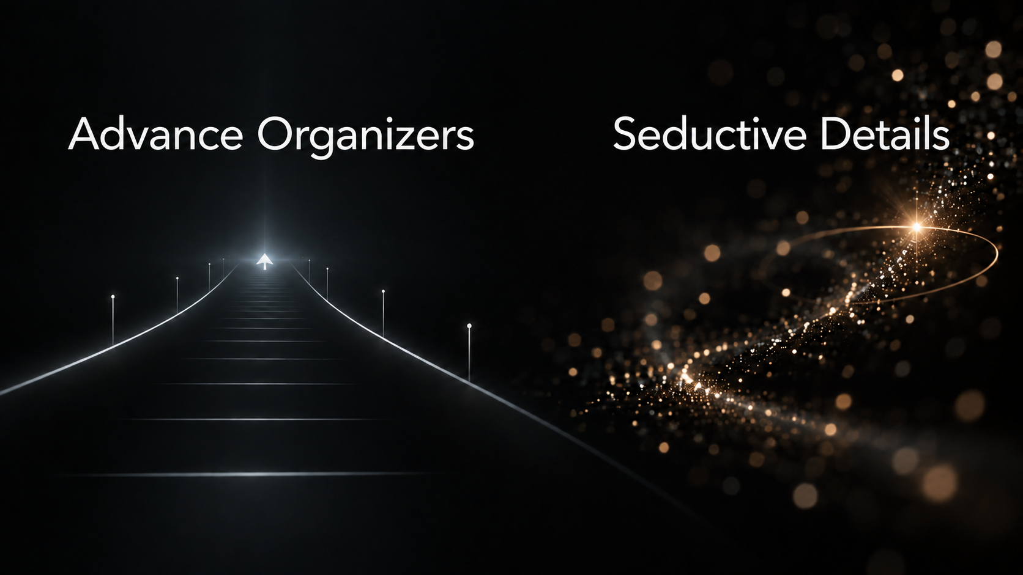

Slide 11
Unmanaged Ambiguity

Slide 12
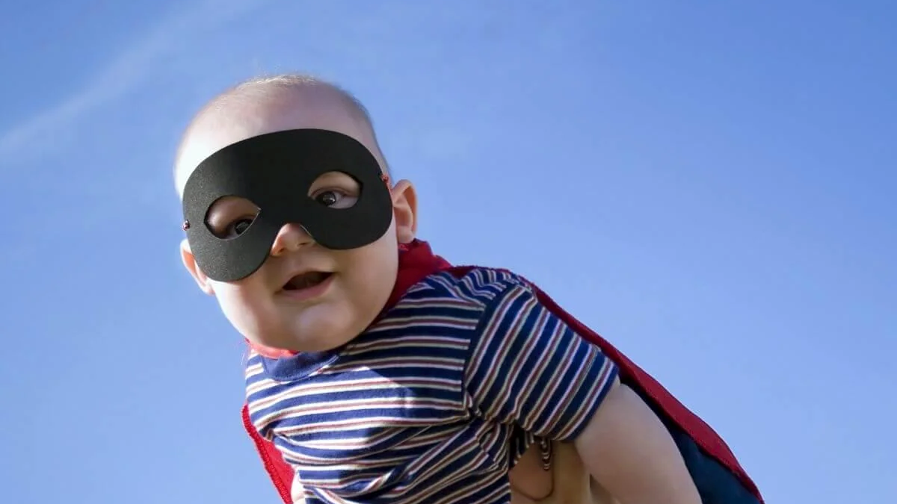

Slide 13
Unestablished Relevance

Slide 14

The Regulation of Cytokines Following Treatment with Dexamethasone, the JAK Inhibitor Ruxolitinib, and the IL-6 Receptor Antagonist Tocilizumab.
Jeffrey D Wisotzkey, Roberta L Hill and Charlotte A Sutcliffe
University of Northern New York
Mayberryville, New York
October 2026

Slide 15
  Closing the Readiness Gap
  Three Questions

Slide 16
  What am I assuming they already know?

Slide 17
  What am I assuming they already know?
  Why should this matter to them, not just me?

Slide 18
  What am I assuming they already know?
  Why should this matter to them, not just me?
  What do they need first, to see what I see?

Slide 19

Start where “they” are…
… then take them where you want them to go.

Slide 20


Slide 21
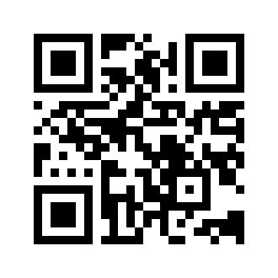
Being Right Isn’t Enough
Jeff Wisotzkey, PhD
Jeff@Speakworth.com
www.Speakworth.com

Slide 22
